Slide 1


ShopCrave-- The Shopping Hub

Slide 2


Overview
Introduction
Project Goals and Objectives
Design and User Experience
Features and Functionality
Technology Stack
React Js Introduction
Project Duration
Conclusion

Slide 3
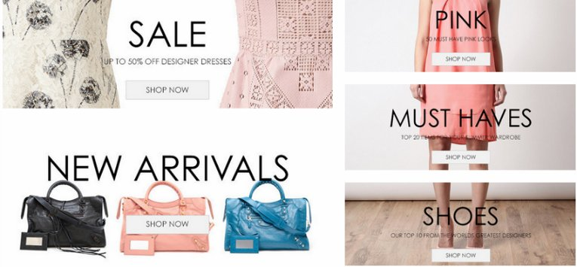
INTRODUCTION
Welcome everyone, today I am thrilled to introduce our latest project - an ecommerce website. In today's market, ecommerce websites have become increasingly important as more and more consumers turn to online shopping for convenience and accessibility.
Our goal with this project is to create a user-friendly and responsive ecommerce website that will not only meet the needs of our clients but also exceed their expectations. We believe that with the right design and technology, we can create a seamless and enjoyable shopping experience for our customers.
This Photo by Unknown Author is licensed under CC BY-SA-NC

Slide 4
Project Goals and Objectives
Our project's primary goal is to create a responsive and user-friendly ecommerce website that meets the needs of modern consumers. This means developing a platform that is easy to navigate, visually appealing, and optimized for mobile devices.
To achieve this goal, we have set several specific objectives. First, we will conduct thorough market research to identify consumer preferences and trends. Second, we will work closely with our design team to create a visually stunning website that reflects our brand and appeals to our target audience. Third, we will prioritize user experience by implementing intuitive navigation, clear product descriptions, and streamlined checkout processes. Finally, we will continually test and optimize our website to ensure that it meets the evolving needs of our customers.

Slide 5
Design and User Experience
Design and user experience are crucial elements of any successful ecommerce website. A well-designed website with a user-friendly interface can greatly enhance the customer's shopping experience, leading to increased sales and customer loyalty.
In our project, we will be incorporating design and user experience into every aspect of the website. From the layout and color scheme to the navigation and product pages, we will be focusing on creating an intuitive and visually appealing website that is easy for customers to use and navigate

Slide 6
Features and Functionality
One of the key features of our ecommerce website is the product listings. Our website will have a user-friendly interface where customers can easily browse through various products and filter them based on their preferences. Each product listing will include detailed information such as product description, price, and availability.
Another important feature is the shopping cart. Customers can add items to their cart while browsing the website and easily view the total cost of their order. The shopping cart will also allow customers to modify their order by removing or adding items. Finally, the checkout process will be streamlined and secure, ensuring a smooth transaction for our customers.

Slide 7

Technology Stack
Our ecommerce website will be built using a powerful and modern technology stack, including React JS, Firebase.
React JS is a popular JavaScript library that provides a fast and efficient way to build user interfaces. It allows us to create reusable components and manage the state of our application with ease. It provides a vast array of libraries and tools that allow us to develop our ecommerce website quickly and efficiently. Finally, Firebase database that provides high scalability, flexibility, and performance. It allows us to store and retrieve data in a fast and efficient manner, making it an ideal choice for our ecommerce website
This Photo by Unknown Author is licensed under CC BY-SA

Slide 8
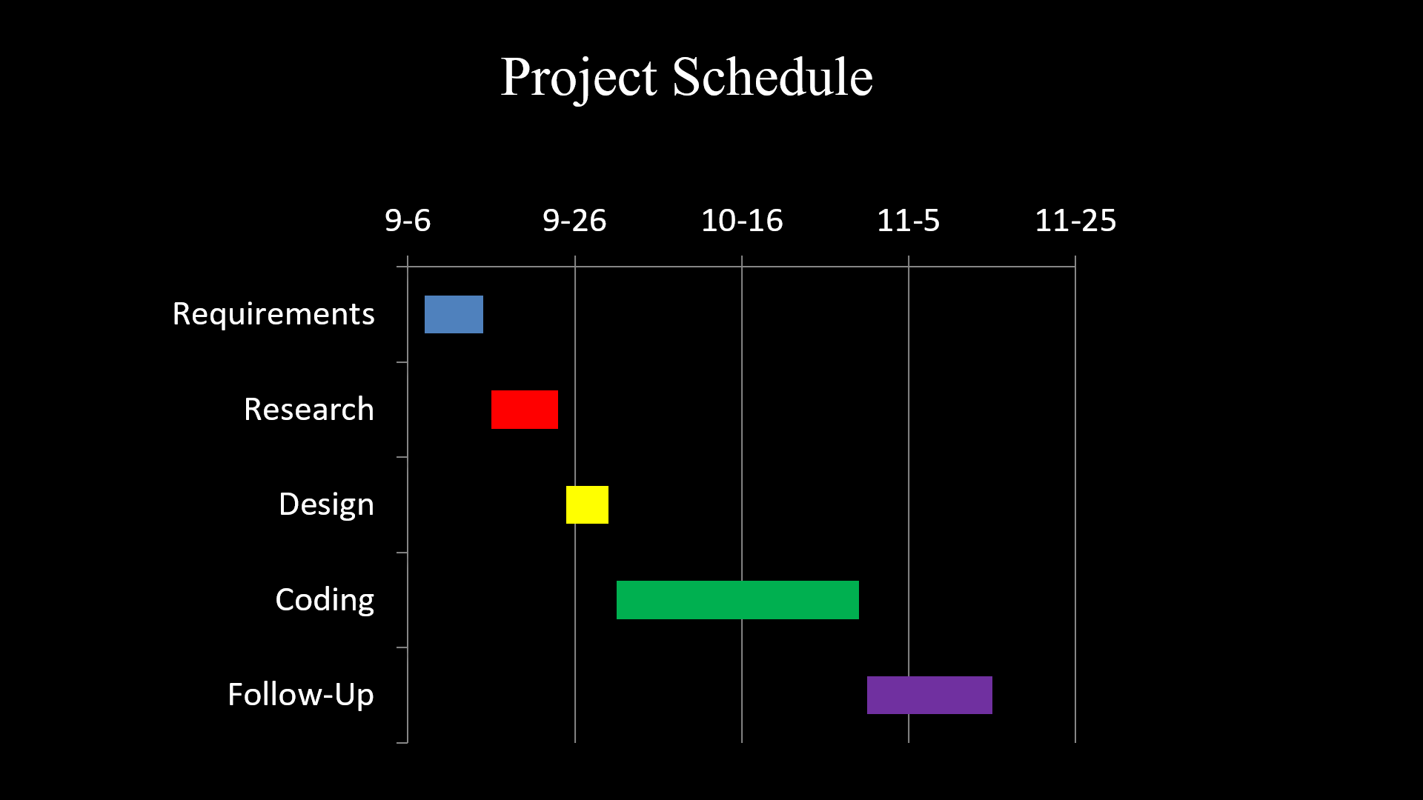

Slide 9
Conclusion
In conclusion, we have discussed the importance of ecommerce websites in today's market and outlined the specific goals and objectives of our project.
We have also emphasized the significance of design and user experience in ecommerce websites, detailed the key features and functionality of our website, and explained the technology stack that will be used to build it.
Through potential challenges and solutions, we have reassured you that the project is in good hands. We are confident that with our expertise and dedication, we will deliver a responsive and user-friendly ecommerce website that meets your needs and exceeds your expectations.

Slide 10


